Slide 1
MSX Presentation
Ahli Bank SAOG
An Overview
September 2022

Slide 2
Contents
Ahli Bank Overview
Operating Environment
Financial Performance
Digital Transformation
Key Focus Areas
Way Forward

Slide 3
Disclaimer
Important Information
The material contained in this presentation is a general background information about Ahli Bank SAOG’s (‘Ahlibank’) current activities as at the date of this presentation. It is information given in summary form and does not purport to be complete. Further, it is also not intended to be relied upon as an advice to investors or potential investors and does not take in to account their investment objectives, financial situation or specific needs of any particular investor. These should be considered, with or without professional advice when deciding if an investment is appropriate.
The information contained here in has been prepared by Ahlibank. Some of the information relied on by Ahlibank is obtained from sources and third party reports believed to be reliable, but does not guarantee its accuracy or completeness. Further, this presentation and discussion are for information purposes only. Any recipients of this presentation and/or discussions, the media must not communicate, reproduce, distribute or disclose through any media (including social media), or refer to them publicly or privately, in whole or in parts anytime without a written consent from the Bank in this regard.
Forward Looking Statements
It is possible that this presentation could or may contain forward-looking statements that are based on current expectations or beliefs, as well as assumptions about future events. These forward-looking statements can be identified by the fact that they do not relate only to historical or current facts. Forward-looking statements often use words such as anticipate, target, expect, estimate, intend, plan, goal, believe, will, may, should, would, could or other words of similar meaning. Undue reliance should not be placed on any such statements because, by their very nature, they are subject to known and unknown risks and uncertainties and can be affected by other factors that could cause actual results, and the Bank’s plans and objectives, to differ materially from those expressed or implied in the forward-looking statements.
There are several factors which could cause actual results to differ materially from those expressed or implied in forward looking statements. Among the factors that could cause actual results to differ materially from those described in the forward-looking statements are changes in the global, political, economic, business, competitive, market and regulatory forces, future exchange and interest rates, changes in tax rates and future business combinations or dispositions etc.
Ahlibank undertakes no obligation to revise or update any forward-looking statement contained within this presentation, regardless of whether those statements are affected as a result of new information, future events or otherwise.
Rounding
Rounding differences may appear throughout the presentation

Slide 4
Contents
Ahli Bank Overview
Operating Environment
Financial Performance
Digital Transformation
Key Focus Areas
Way Forward

Slide 5




Ahli Bank Overview
Ahli Bank – Evolution
Key Performance Highlights
Commercial banking operations commenced in 2007
As of June 2022, the bank has 39 branches including 17 islamic branches
Bank has 5 main business segments viz., retail banking, commercial banking, investment banking, treasury & financial institutions, and Islamic banking
Bank has a strong institutional shareholding in share capital.
As of June 2022, the bank had a market share of 9.3% in terms of Gross Loans and 8.6% in terms of Customer Deposits
Fitch rating has assigned a credit rating of B+ with a stable outlook
Total Assets
9.9% (5-Yr CAGR)
Deposits
11.4% (5-Yr CAGR)
OMR 1.90 Bn
2016
OMR 3.05 Bn
2021
OMR 1.27 Bn
2016
OMR 2.18 Bn
2021
Gross Loans
9.9% (5-Yr CAGR)
Branch Network
OMR 1.55 Bn
2016
OMR 2.48 Bn
2021
20 Branches 2016
37 Branches
2021
Shareholding Structure
Key Achievements
Total Assets over > RO 3Bn
Incremental market share last 3-Yrs at c.26% in Gross loans and c.25% in deposits
Highest ROAE in the industry
Lowest NPL ratio in the industry without any technical write-offs
Second lowest cost to income ratio in the industry
First Islamic Bank in Oman to launch digital NTB onboarding with c.80% of onboarding done
First Bank in Oman to launch Tamkeen, a Crowd funding platform for SMEs through Fintech collaboration
Incremental market share from 2018-21 based on 7 Listed Local Banks

Slide 6
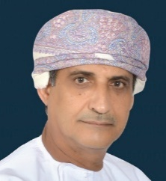
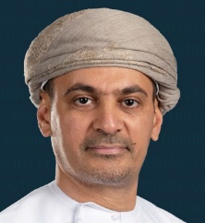
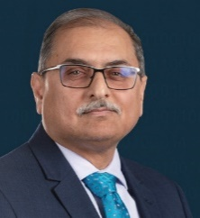
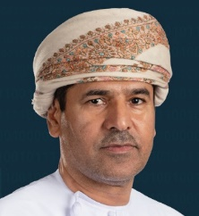
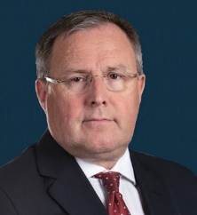
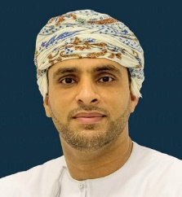
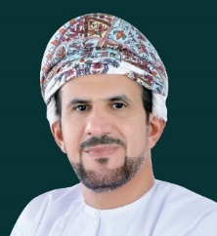
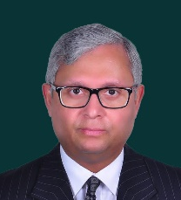
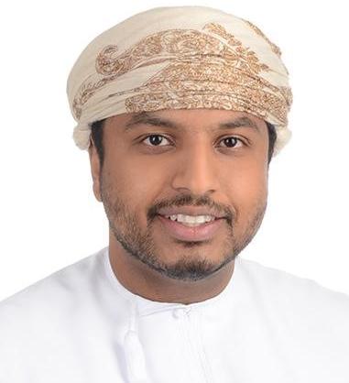
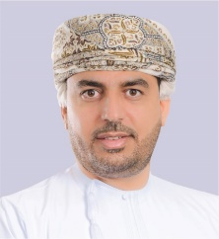
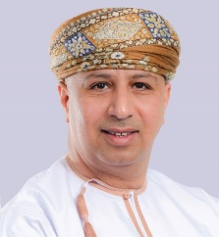
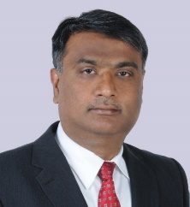
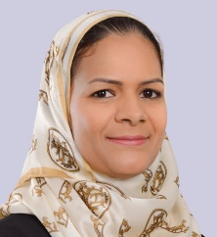
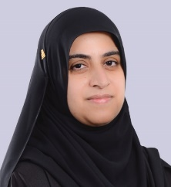
Board of Directors & Management Team
Chairman
First Deputy Chairman
Second Deputy Chairman
Board Directors
Corporate Governance Structure
Hamdan Ali Nasser Al Hinai
Anwar Hilal
Al Jabri
Sanjeev Baijal
Abdul Hameed Ahmed Al Bulushi
Keith Henry Gale
Ibrahim Said Badar Al Eisri
Salim Ali Hamed Al Hasni
Wajid Ali Khan
Qais Abdullah Al Kharusi
Board Committees
Audit & Compliance Committee
Executive & Credit Committee
Executive
Risk
Committee
Nomination & Remuneration Committee
Digital
Transformation Committee
1
2
3
4
5
Chief Executive
Officer
Deputy CEO
Support Services
Deputy CEO Business Group
General Manager
Head of Corporate Banking
General Manager
Head of Risk Management
Executive Management
Said Abdullah
Al Hatmi
Abdullah Salim
Al Jabri
Bilal Anwar
Hanaa Mohammed
Al Kharusi
Ghada Abdul Latif
Al Balushi

Slide 7
Business Segments
Retail Banking
Wholesale Banking
Retail Banking
Strong emphasis on designing and offering innovative products and services
Consists of specialized teams dedicated for Retail, Premium, Private Banking, Wealth management and Islamic Banking customers.
Offering services through multiple distribution channels including 39 branches across the Sultanate of Oman (including 17 Islamic branches)
Bank continues to focus on expansion of retail network including digital branches.
Widen customer base of target segment both under conventional and Islamic banking business.
Corporate Banking & SME
Offering full array of services through sector specific teams
Continuous focus on the sectors that form part of the Sultanate’s diversification strategy and Vision 2040
Includes Government Banking, Corporate Liabilities & E-channels team.
Treasury & FI
Provides a comprehensive package of services to corporate, commercial and government institutions.
Financial Institutions Group covers global relationships with other financial institutions and acts as an international arm of ahlibank
Investment Banking
The Corporate Finance Advisory division is a full-service financial advisory and fundraising platform with proven track record across products categories.
Continued focus on building cross border transactions and regional origination and placement capabilities.
Asset management division offers a diverse range of investment solutions for its institutional and high net worth clients including mutual funds and investment advisory services across asset classes.
The brokerage division is a leading player in the Muscat Stock Exchange servicing broad range of institutional and retail clients.
OMR Mn
Retail Banking
2020 2021 June 2022
Wholesale Banking
2020 2021 June 2022
OMR Mn
Total Assets
Net Operating Income
739 730 730
22.7 28.2 14.6
1,965 2,323 2,317
48.8 54.2 30.1

Slide 8
Islamic Banking
Islamic Banking
ahli Islamic has shown robust growth since its launch in 2013
The Sharia-compliant products and services offered by ahli Islamic cater to all customer segments including institutional, corporate, SME and retail, through 17 dedicated branches
Customer Deposit grew by 5-Yr CAGR of 18.2% compared to Ind.Avg of 15.2%
Retail deposit grew by 55.7% by 5-Yr CAGR of 55.7% compared to Ind.Avg of 30.1%
Continued focus on low cost deposits and retail expansion plans.
ahli Islamic offers unmatched Sharia compliant products to customers under all categories – Deposits, Financing, Cards, FX, Transfers etc.
First Islamic Bank in Oman to digitally board customers through Mobile Banking platform.
CAGR : 16.0 %
CAGR : 11.6 %
CAGR : 30.1 %
OMR Mn

Slide 9
Contents
Ahli Bank Overview
Operating Environment
Financial Performance
Digital Transformation
Key Focus Areas
Way Forward

Slide 10
Macro Economic Overview
Economic Outlook
The Sultanate of Oman’s Economy is estimated to register a Real GDP growth of 4.4% in 2022 compared to 3.0% in 2021 supported by growth in the non-hydro carbon sector and improvement in the overall oil price.
Oman’s Economy was earlier impacted by the dual shock of the pandemic and collapse in the oil prices in 2020.
According to credit rating agency Fitch’s recent report Oman’s Real GDP is projected to grow by 2.8% in 2023 and around 2% in 2024-2025.
Inflation forecast to average around 3.5% in 2022 and is expected to moderate below 2% in 2023-2024.
Oman Government through its Medium Term Fiscal Plan (MTFP) has taken a number of measures to instill fiscal stability and reduce the overall debt burden of the country.
Source: Fitch Solution, World Bank, CBO
Credit Rating Outlook
Fitch Rating Agency recently updated graded Oman’s Long-Term Foreign Currency Issuer Default Rating from ‘BB-’ to ‘BB’ with a Stable outlook.
Oman registered budget surplus of RO784Mn first time since 2013, supported by higher oil prices in 2022,
Budget surplus is forecast at 5.5% and 3.4% of the GDP in 2022 and 2023.
Fiscal
B/E $67
Source: S&P Global Commodities
S&P
Fitch
Moody’s
Oman’s
Credit Ratings
BB-
Stable
BB
Stable
Ba3
Stable
Source: Fitch Report – Aug’22
Source: Fitch Solutions & IMF

Slide 11






Banking Sector Overview
Omani banks' credit fundamentals are recovering as pressures on the operating environment have eased and economic activity is gradually picking up amid higher oil prices.
Oman banking sector operating environment factor scores to stable from negative
Asset quality will remain a key risk in 2022 with the run-off of payment holidays and a rising interest rate (recent increase of 75 basis points) environment which could undermine borrowers' debt servicing capacities.
High quality concentrations will continue to pose downside Risk to asset quality
Sound capital provide loan-loss absorption capacity, even under stress scenario
Recent Macro Stress Testing undertaken by CBO revealed strong resilience of the Omani banking system
Pressures on banks' funding and liquidity profiles have eased in the recent past, underpinned by government support measures combined with the recent rebound in oil prices.
Performance metrics recovered substantially in 2021 and this is expected to continue in 2022
Loan loss provisions will continue to remain high in the short to medium term, owing to post covid-19 impacts and conservative provisioning policy adopted by banks.
Operating Environment
Authorities' willingness to provide support will remain high
Oman reported a budget surplus of RO784Milion (US$2Billion) at the end of first half of 2022
Source: CBO
Asset Quality
Capital
Funding & Liquidity
Profitability & Efficiency
Government Support
Source: CBO, Fitch Ratings

Slide 12
Contents
Ahli Bank Overview
Operating Environment
Financial Performance
Digital Transformation
Key Focus Areas
Way Forward

Slide 13
Key Metrics (As of June 2022)
Gross Loans
4.1%
Deposits
1.4%
Balance Sheet
Profit & Loss
Operating Income
13.3% YOY
NPAT
18.6% YOY
Key Ratios

Slide 14
Operating performance and Profitability

Slide 15
Deposits and Loans
CAGR : 9.7 %
CAGR : 8.7 %
Second highest incremental market share from 2018-2021 based on 7 Listed Local Banks
Highest incremental market share from 2018-2021 based on 7 Listed Local Banks

Slide 16
Credit Performance : Stage wise Exposure
NPA & Coverage Ratio
Stage 1
ABO :
3.4%
ABO :
81.7%
Ind Avg :
4.4%
Ind Avg :
80.7%
Stage 2
Stage 3
ABO :
15.7%
ABO :
2.7%
Ind Avg :
16.3%
Ind Avg:
3.0%
Stage wise exposure and ECL % (includes all financial assets, commitments, LCs & LGS) of 7 Listed Local Banks

Slide 17
Contents
Ahli Bank Overview
Operating Environment
Financial Performance
Digital Transformation
Key Focus Areas
Way Forward

Slide 18




Digital Transformation Strategy
A well defined 3 year Digital Transformation Roadmap
Customer Experience
Instant
Offer best in class customer experience across all digital touchpoints
Instant customer servicing aimed at reducing Turn around time for the customers
Digital Strategy
Innovative
Agility
Offer innovative products & services through collaboration with Fintechs
Build an Agile organization culture to meet changing customer needs
Key Focus Areas under Digital
Efficiency Improvement
Business Expansion
Enhancing CX

Slide 19


Fintech Collaboration | Crowd Funding
TAMKEEN
Launched ‘Tamkeen’ Crowd Funding initiative to support Omani SMEs on 14th June
In strategic partnership agreement with Beehive
Contribute towards a more inclusive entrepreneurial ecosystem
Benefits include quick and seamless access to financing for SMEs; financial packages between OMR 20-80k, at competitive pricing, unsecured lending, streamlined processes & faster turnaround time
Cutting-edge digital lending solutions that are accessible, cost-effective, provide enhanced security & financial inclusion
SMEs registered in Oman increased by 44.3%
In collaboration with
Beehive Oman
Total SMEs in Oman: 75,800
Medium Enterprise > 2,695 (3.6%)
Small Enterprise: > 9,880 (13.0%)
Micro Enterprise > 63,225 (83.4%)
Increased need for Bank-Fintech to collaborate than to compete
Source: NCSI – May’22

Slide 20
Contents
Ahli Bank Overview
Operating Environment
Financial Performance
Digital Transformation
Key Focus Areas
Way Forward

Slide 21
Key Focus Areas
Growth in Deposit & Customer base
Enhance Fee
Income
Prudent Asset Growth
Continue Digitalization
Expanding and diversification of overall customer base of the Bank
Enhance retail deposit contribution to the overall funding mix
Increase customer touchpoints through digital channels including digital branches
Enhance the share of non-interest income in line with the industry standards
Increase business avenues and opportunities to expand fee based income
Capitalize further on digital channels to increase product per customer ratio
Prudent loan growth in line with Oman’s key focus sectors, including SME financing, as per Vision 2040
Continue to maintain high quality credit by adopting robust risk management practices
Focus on sunrise industries to achieve economic diversification of assets
Enhance overall Digital Customer Experience across channels
Increase Digital Sales
Focus on analytics driven channel offering for customers
Implement straight through digital processing
Explore fintech collaboration
Continued focus on increasing Bank’s market share

Slide 22
Contents
Ahli Bank Overview
Operating Environment
Financial Performance
Digital Transformation
Key Focus Areas
Way Forward

Slide 23
Conclusion
Asset Growth: Continue to adopt prudent approach in loan growth
Digital Transformation: Offering innovative digital products & services through active fintech collaboration
Expand Deposit Base: Expanding and diversification of overall customer base of the Bank
Enhance Fee Income: Increase share of Other Income to Total Income
Improve Operational Efficiency: Maximizing STP through adoption of digital and robotic process automation
1
2
Way
Forward
3
4
5

Slide 24
Thank you

